Slide 1

Using Network Traffic Data to Investigate Potentially Compromised Machines
Special Thanks:

Slide 2
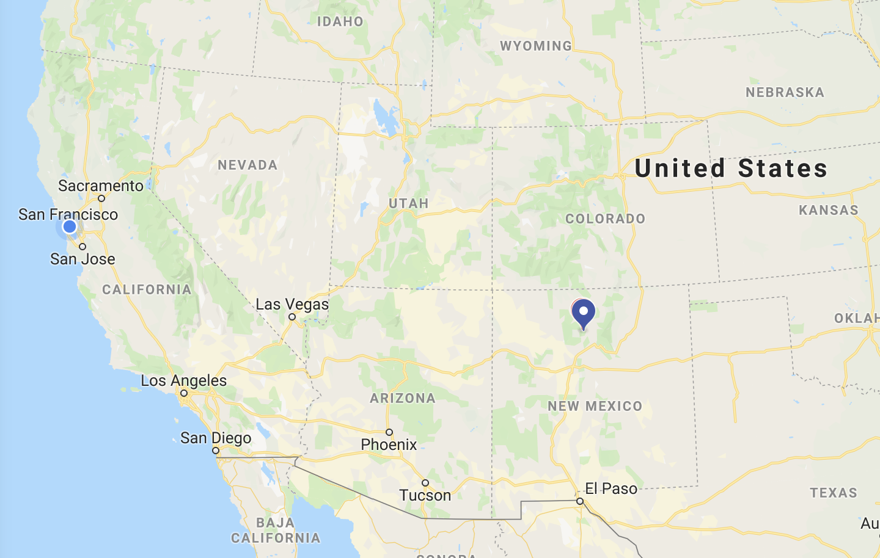
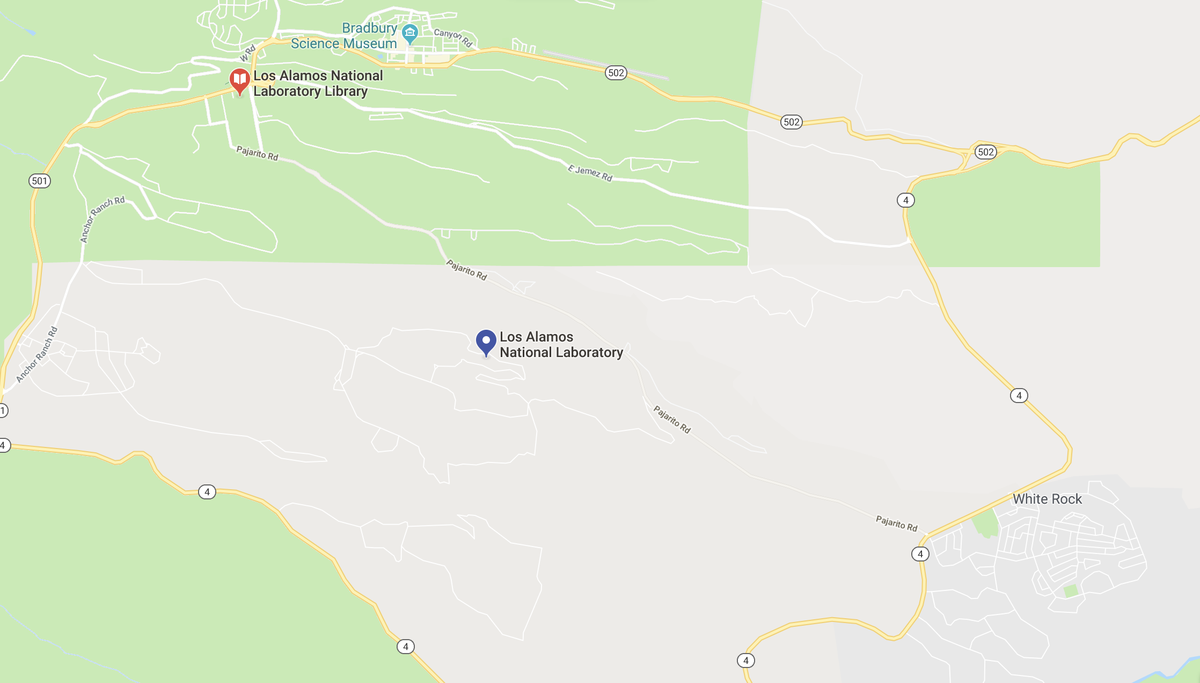

Where Is Our Data From?
This data set represents 58 consecutive days of de-identified event data collected from five sources within Los Alamos National Laboratory’s corporate, internal computer network.
The Data Set Presented is collected from known human users and contains ~100 users whose computers are known to be Compromised

Slide 3


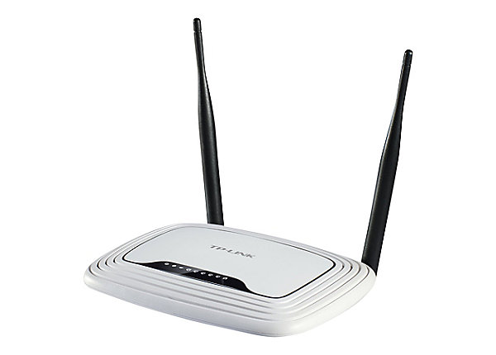

Network Interactions Example
Source | Destination | Size | User | Service
Cat | Gmail | 1Mb | Cat | Gmail
Gmail | Dog | 1MB | Dog | Gmail

Slide 4
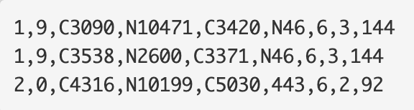
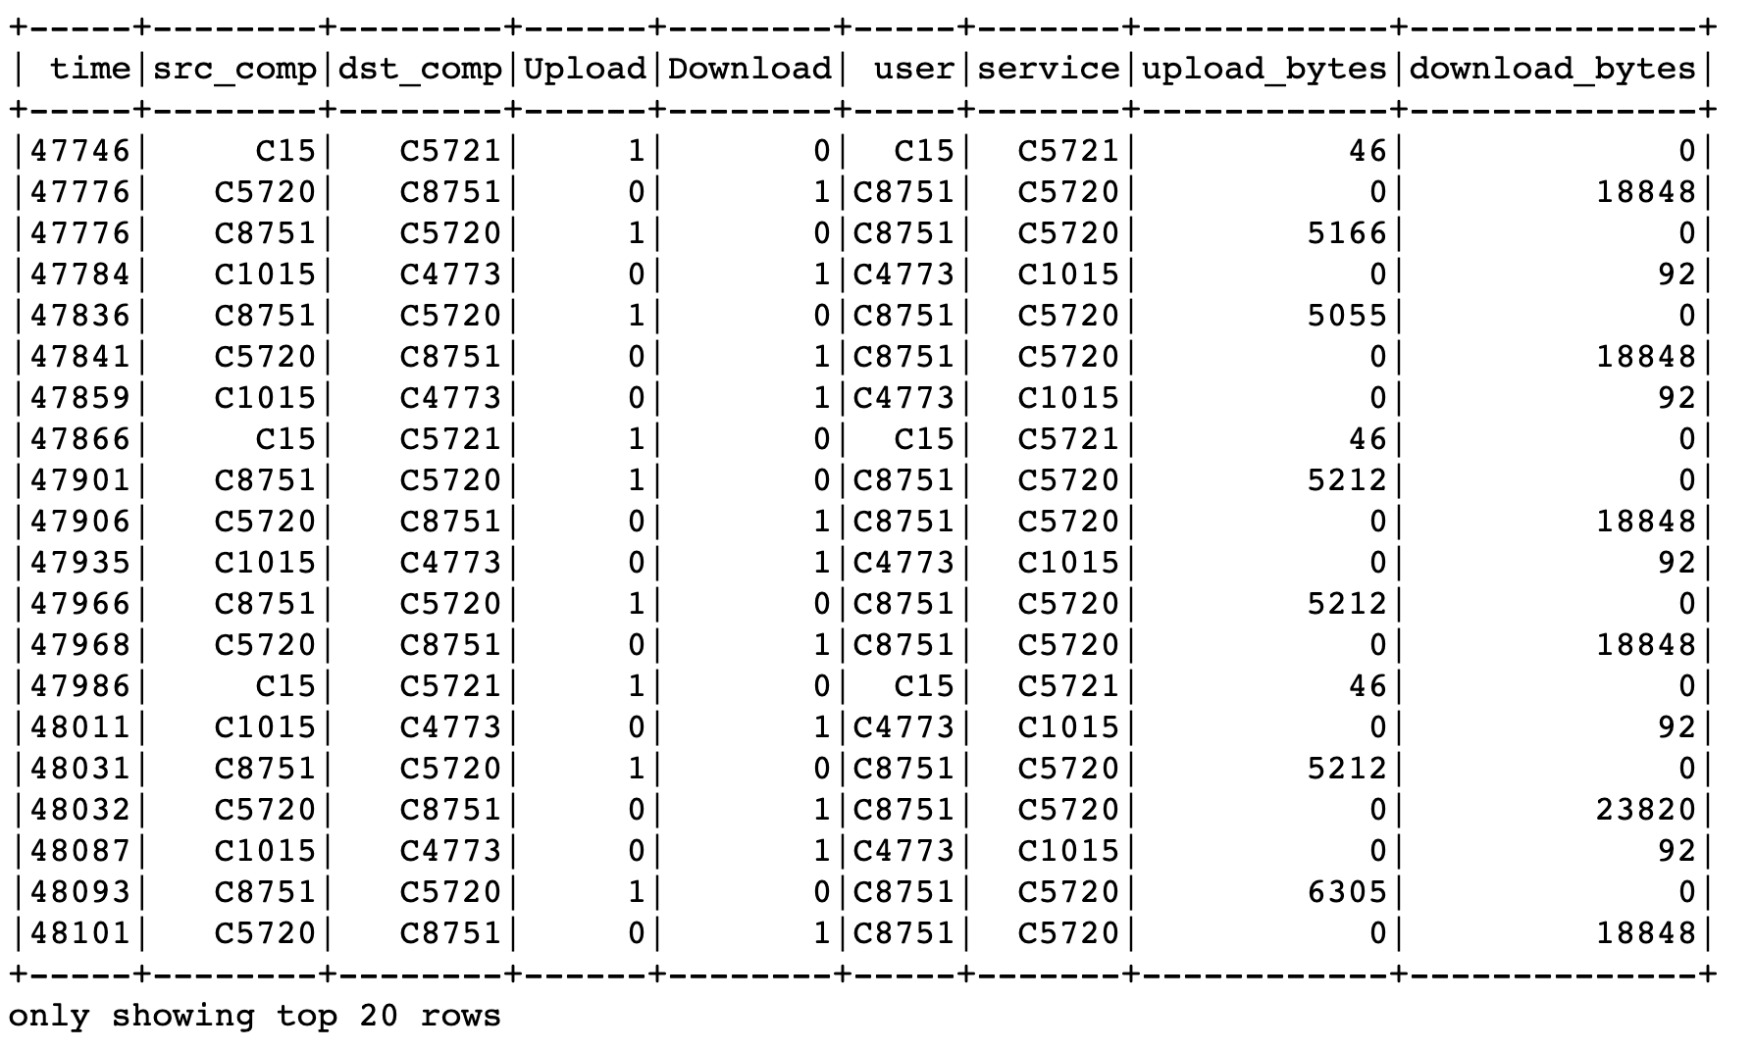
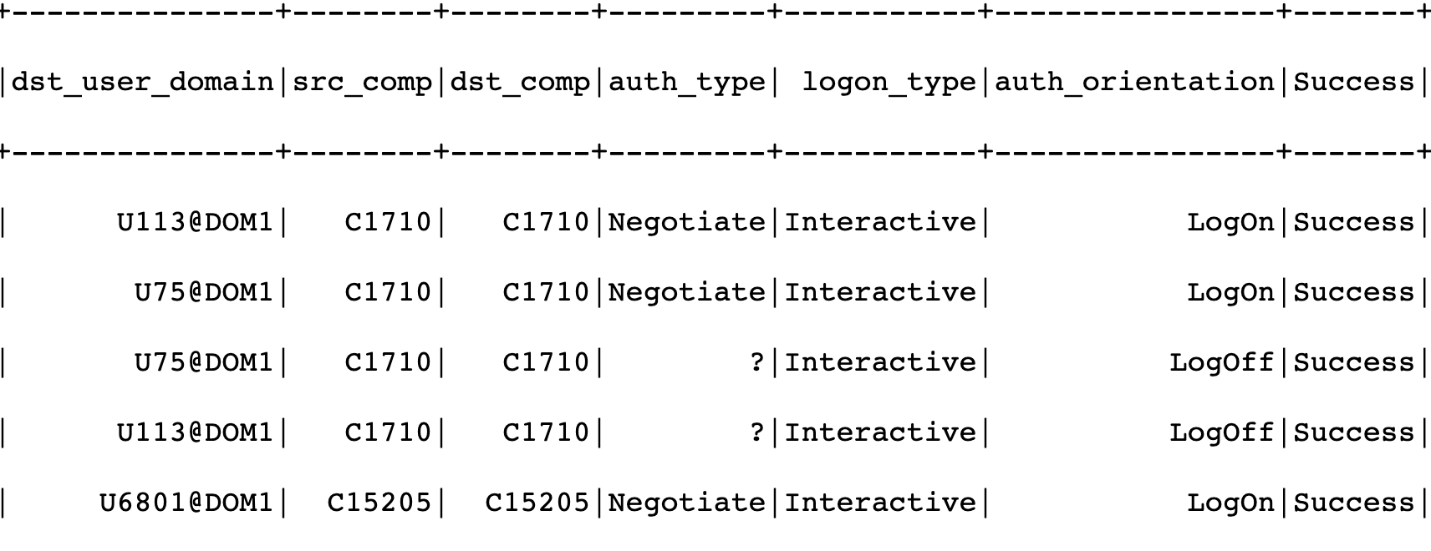


FLOW.txt
Filled DataFrame
AUTH.txt

Slide 5
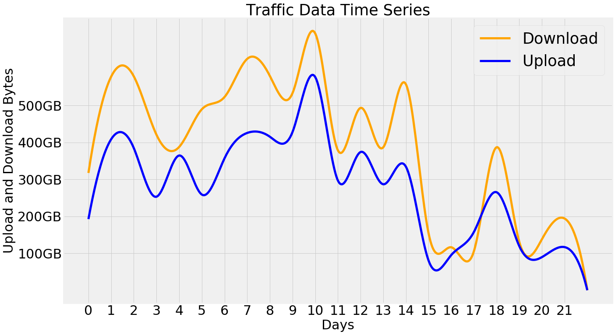

Slide 6
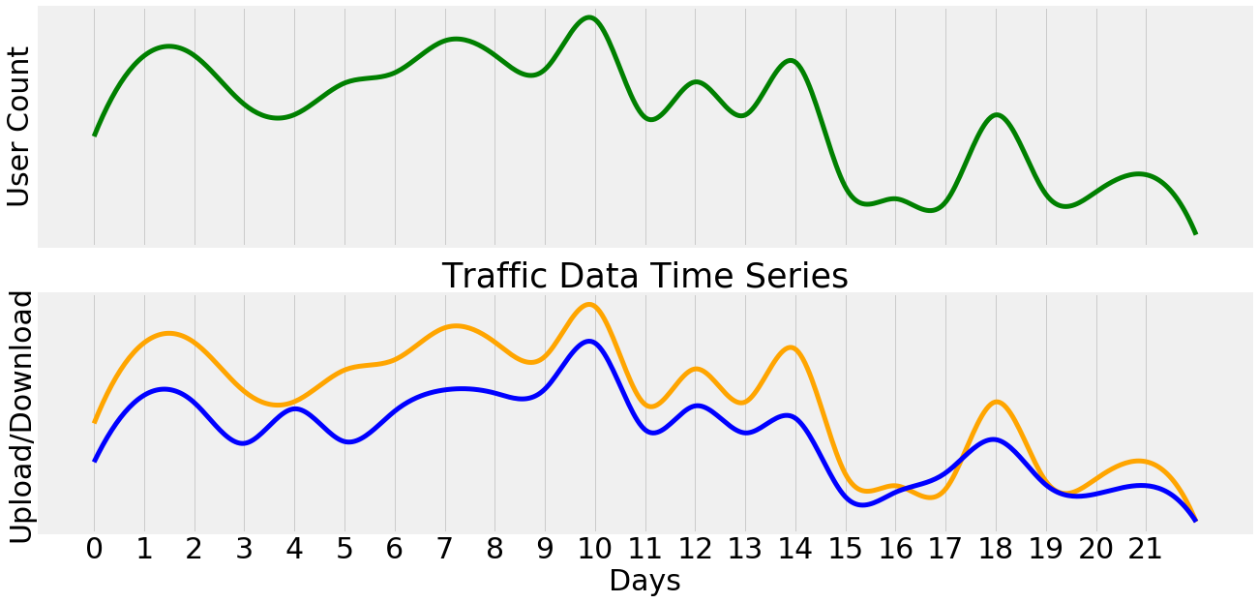

Slide 7
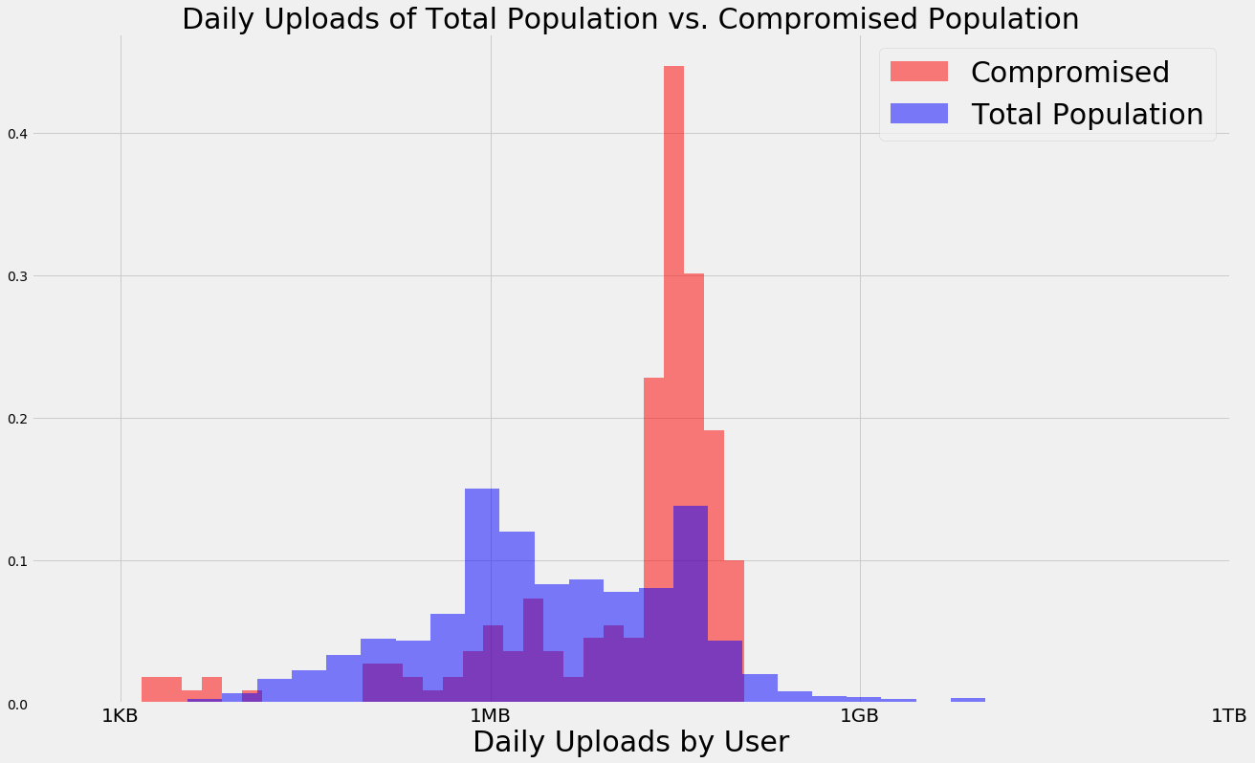
Compare Distributions of Daily Uploads
H₀=50% chance any random item from Compromised exceeds any random item from total
α = .05
Run Mann Whitney U Test on the two distributions
P=1.2472e-20

Slide 8
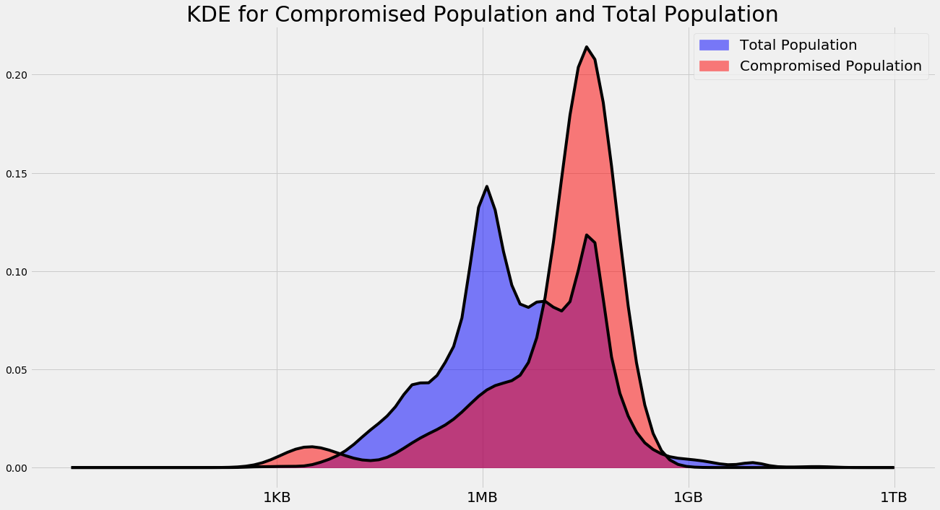
Kernel Density Estimation

Slide 9
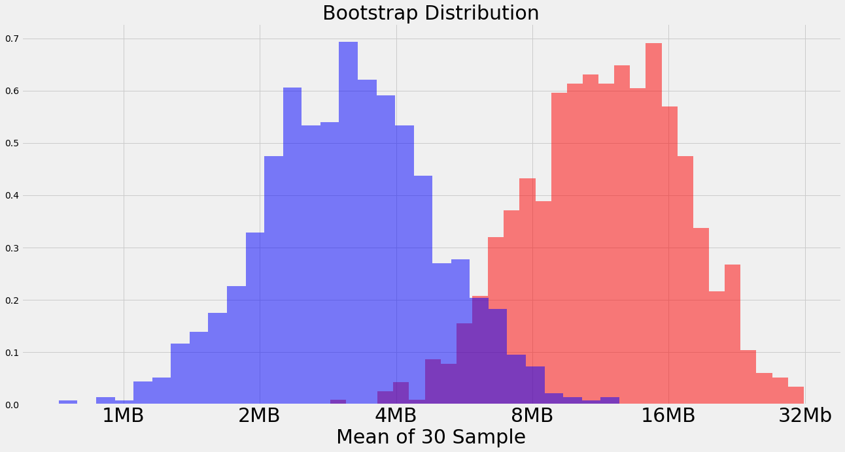
Further Questions
Given a group of 50 users is it possible to tell whether they were likely drawn from the Total Population of from the distribution of compromised users?

